Slide 1

Faculty of Applied Engineering and Urban Planning
Civil Engineering Department
Dr. Eng. Mustafa Maher Al-tayeb
2 Semester 2022/2023
Probabilistic and Statistical

Slide 2
Chapter 5
(part 2)
Mean,
Variance and Standard Deviation
of
Probability
Distribution

Slide 3
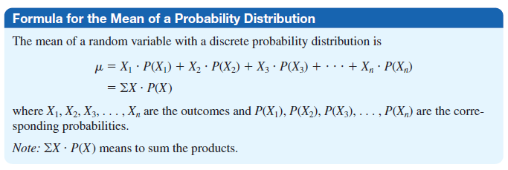
Mean
of
Probability
Distribution

Slide 4
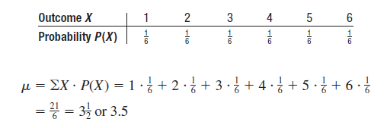
Ex 1. Find
when a die
the mean
of
the
number
of
spots
that
appear
is
tossed.
Solution:

Slide 5
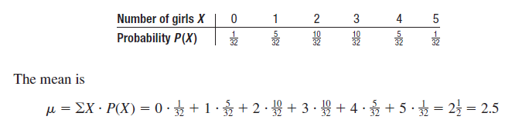
Ex 2. In families with five children,
find
the
mean
number
of children
who
will
be
girls.
Solution:

Slide 6
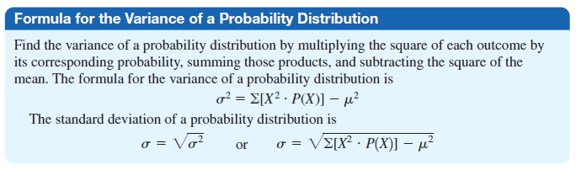
Variance and Standard Deviation
of
Probability
Distribution

Slide 7

Ex.3 Compute the variance and standard
deviation
for
the probability
distribution
in
Example
1.
Solution
:

Slide 8
Probabilistic and Statistical Techniques
Mean, Variance and Standard Deviation of a
Probability Distribution
Mean
Variance
Variance (shortcut)
Standard Deviation
Notes:
In Chapter 3, we found the mean, standard deviation ,variance, and shape of the distribution for actual observed experiments.
The probability distribution and histogram can provide the same type information.
These formulas will apply to ANY type of probability distribution as long as you have all the P (x) values for the random variables in the distribution.
In section 4 of this chapter, there will be special EASIER formulas for the special binomial distribution.
The TI-83 and TI-83 Plus calculators can find the mean, standard deviation, and variance in the same way that one finds those values for a frequency table.
With the TI-82, TI-81, and TI-85 calculators, one would have to multiply all decimal values in the P(x) column by the same factor so that there were no decimals and proceed as usual.
Page 204 of Elementary Statistics, 10th Edition

Slide 9
Example 1
Probabilistic and Statistical Techniques
The following table describing the probability distribution for number of girls among 14 randomly selected newborn babies. Assuming that we repeat the study of randomly selecting 14 newborn babies and counting the number of girls each time, find:
The mean number of girls
The variance
The Standard deviation

Slide 10
Probabilistic and Statistical Techniques
Probabilistic and Statistical Techniques
Probabilistic and Statistical Techniques
Probabilistic and Statistical Techniques
x | P(x) | x.P(x) | x² | x².P(x)
0 | 0 | 0 | 0 | 0
1 | 0.001 | 0.001 | 1 | 0.001
2 | 0.006 | 0.012 | 4 | 0.024
3 | 0.022 | 0.066 | 9 | 0.198
4 | 0.061 | 0.244 | 16 | 0.976
5 | 0.122 | 0.61 | 25 | 3.05
6 | 0.183 | 1.098 | 36 | 6.588
7 | 0.209 | 1.463 | 49 | 10.24
8 | 0.183 | 1.464 | 64 | 11.71
9 | 0.122 | 1.098 | 81 | 9.882
10 | 0.061 | 0.61 | 100 | 6.1
11 | 0.022 | 0.242 | 121 | 2.662
12 | 0.006 | 0.072 | 144 | 0.864
13 | 0.001 | 0.013 | 169 | 0.169
14 | 0 | 0 | 196 | 0
 |  | 6.993 |  | 52.47

Slide 11
Probabilistic and Statistical Techniques
Probabilistic and Statistical Techniques
Example 2
A statistics class of 25 students is given a 5 point quiz.
3 students scored 0,
1 students scored 1,
4 students scored 2,
8 students scored 3,
6 students scored 4,
and 3 students scored 5.
If a student is chosen at random, and the random variable x is the student’s quiz score then the probability distribution of x is:
x | 0 | 1 | 2 | 3 | 4 | 5
P(x) | 0.12 | 0.04 | 0.16 | 0.32 | 0.24 | 0.12

Slide 12
Probabilistic and Statistical Techniques
Example 2
Find The mean of the random variable s
x | 0 | 1 | 2 | 3 | 4 | 5
P(x) | 0.12 | 0.04 | 0.16 | 0.32 | 0.24 | 0.12
X*P(x) | 0 | 0.04 | 0.32 | 0.96 | 0.96 | 0.60
Solution

Slide 13
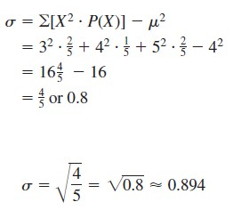
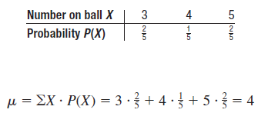
Ex.6 A box contains 5 balls. Two are numbered 3, one is
numbered
4,
and two
are
numbered
5. The balls
are
mixed
and
one
is
selected
at
random.
After
a
ball is
selected, its number is recorded. Then it is replaced. If
the experiment is repeated many times, find the variance
and standard
deviation
of
the
numbers
on
the
balls.
Solution:

Slide 14
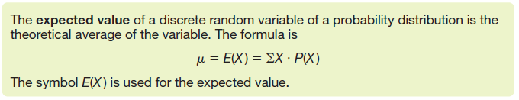
Expectation

Slide 15
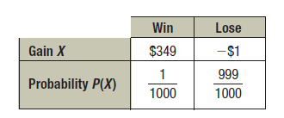

Ex.7 One thousand tickets are sold at $1 each for a color
television valued at $350. What is the
expected
value
of
the gain if
you
purchase
one
ticket?
Solution:

Slide 16
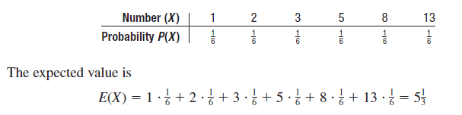
Ex.8 Six balls numbered 1, 2, 3, 5, 8, and 13 are placed
in a box. A ball is selected at random, and its number is
recorded and then it is replaced.
Find
the
expected
value
of the numbers
that
will
occur.
Solution:

